Slide 1
How long, and how often, to measure borehole temperature
PHIRE · HENRY ICE RISE · DRAFT FOR COMMENT
Survey design for recovering the undisturbed ice temperature after drilling
October 2026

Slide 2
Two design questions
QUESTION 1
QUESTION 2
One return visit, or two?
Near-continuous logging, or a few readings?
Is a reading a year after drilling close enough to the undisturbed ice temperature, or do we need to go back after two years?
Logging is possible with the right kit. The alternative is a few readings within weeks of installing the instrument, then one a year later.
What we would like from you: whether the reasoning holds, what the model is missing, and which design you would choose.

Slide 3
The measurement problem
Drilling warms the ice
We can only measure in the hole
The warmth fades slowly
Making the hole holds its wall at 0 °C for somewhere between a day and a week. That heat spreads into the ice around it.
There are no sensors in the surrounding ice. The temperature in the borehole itself is the only record we get.
The borehole cools back towards the temperature the ice had before drilling, over years rather than weeks.
The design question is how late, and how often, we must read the borehole temperature to recover that undisturbed value.

Slide 4
Model of the recovery
Heat conduction outward from the hole, in one dimension (radius), solved numerically.
under 1 mK
difference from the exact solution for a cylinder held at a fixed temperature (Carslaw and Jaeger)
Ice before drilling | −5 °C everywhere
Hole wall during drilling | held at 0 °C for 1 day or for 7 days
Hole wall afterwards | no heat flow; temperature free to relax
Hole radius | 5 cm
Borehole reading | the temperature at the hole wall
×5 at −25 °C
every error here scales with how far the ice is below 0 °C, so colder ice gives proportionally larger errors

Slide 5
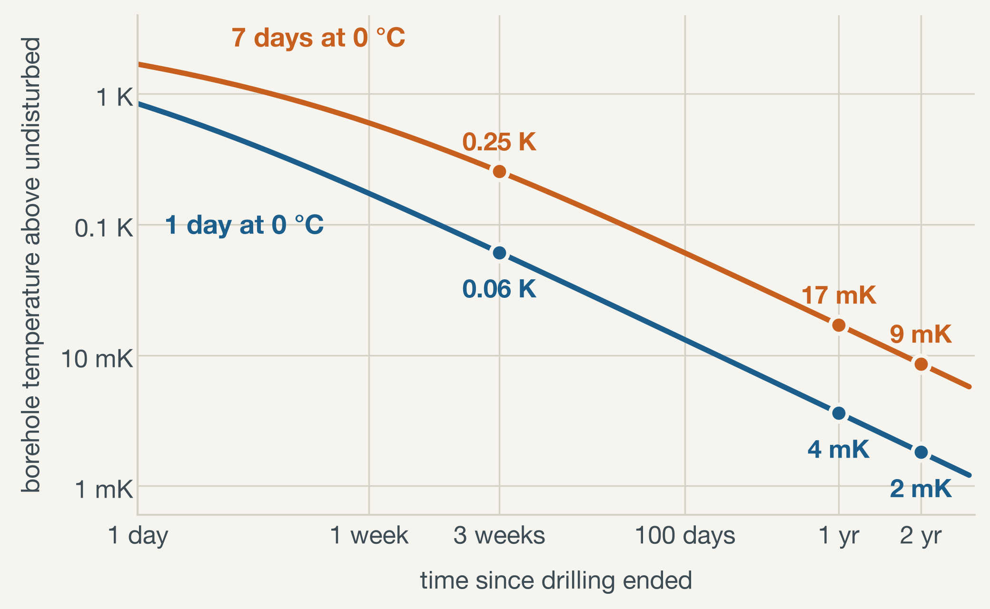
Size of the disturbance
Borehole temperature above the undisturbed value. Each range runs from 1 day to 7 days with the wall at 0 °C.
0.06–0.25 K
three weeks after drilling
4–17 mK
one year after
2–9 mK
two years after
Model results for ice at −5 °C and a hole radius of 5 cm.

Slide 6
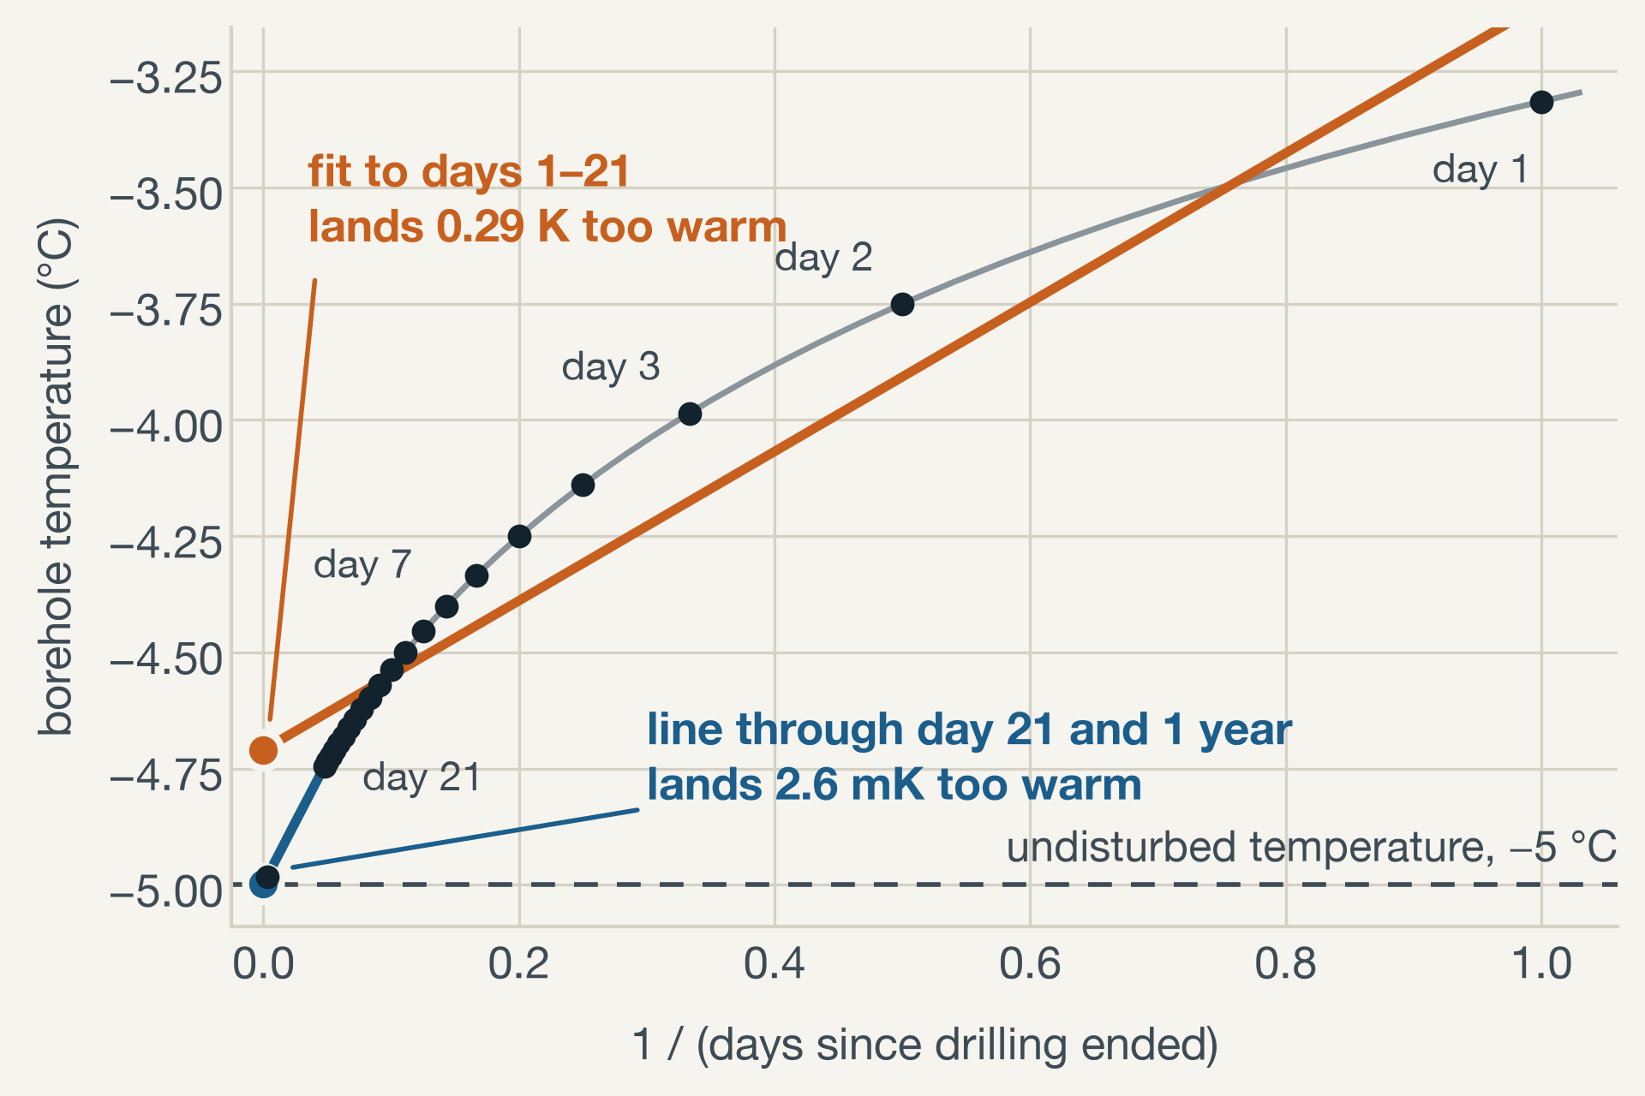
Extrapolation to the undisturbed temperature
Long after drilling, the borehole temperature T follows
T = T0 + Q / (4πk t)
so a plot against 1/t is a straight line that points at the undisturbed temperature T0 (Humphrey and Echelmeyer, 1990).
This only holds once t is several times the heating duration s. A line fitted to readings taken around time t still leaves about s / (s + 2t) of the disturbance.
Example: 7 days at 0 °C, ice at −5 °C. Readings are model output with no measurement noise.

Slide 7
Question 1: one year or two
Error in the estimated undisturbed temperature, in millikelvin. In each cell the first figure is for 1 day at 0 °C and the second for 7 days.
What goes into the estimate | After the year-1 visit | Adding a year-2 visit
Latest reading, taken at face value | 3.6 / 17 | 1.8 / 8.6
Year-1 and year-2 readings joined by a 1/t line (reading noise ×2.2) | needs both visits | below 0.1 / 0.1
Readings on days 7, 14 and 21 plus the visit readings, fitted with a free time shift | below 0.1 / 0.5 | below 0.1 / 0.3
Daily logging, best choice of days, including 1 mK of reading noise | 0.1 / 0.2 to 0.5 | below 0.1 / 0.1 to 0.2
A second visit halves the error of a face-value reading. Once first-year readings are extrapolated, it adds little.
Model results for ice at −5 °C and a hole radius of 5 cm. The free time shift fits T = T0 + A / (t + t0).

Slide 8
Question 2: a few readings or a logger
Method error in millikelvin: 1 day / 7 days at 0 °C. Reading days are counted from the end of drilling.
Readings and fit | Method error (mK) | Reading noise passed on | Needs heating duration
One reading at 1 year, taken at face value | 3.6 / 17 | ×1 | no
Days 7, 14, 21 and 1 year: plain 1/t fit | 2.3 / 36 | ×0.8 | no
Day 21 and 1 year: 1/t line | 0.1 / 2.6 | ×1.1 | no
Day 21 and 1 year: ln(1 + s/t) line | below 0.1 / 0.3 | ×1.1 | yes
Days 7, 14, 21 and 1 year: free time shift | below 0.1 / 0.5 | ×1.1 | no
Daily logging for a year: best days and fit | below 0.1 / 0.1–0.4 | ×0.1 to ×0.3 | no
With early readings only in week one, the 7-day errors grow to 5.7 mK (1/t line) and 2.6 mK (time shift). A twofold error in the heating duration s moves the ln line by about 1.5 mK.
Ice at −5 °C, hole radius 5 cm. Reading noise passed on: the share of one reading's random error that reaches the estimate.

Slide 9
Trade-offs between the two designs
A few readings, then one at a year
Near-continuous logging
Method error of a few millikelvin or less, provided the last early reading comes about three heating durations after drilling and the early readings do not dominate the fit.
Similar method error, with the freedom to choose afterwards which readings to fit.
Daily readings average random noise down about tenfold. Sensor drift is not averaged away.
The single late reading passes its full noise, and any sensor drift, straight into the answer.
The record shows the shape of the cooling, so the model and the time shift can be checked against it.
Nothing in the data shows whether the cooling followed the model.

Slide 10
One year is long enough in the model. What matters more is having earlier readings to extrapolate from, and not letting the earliest ones dominate the fit.
WHAT THE MODEL SAYS

Slide 11
Limits of the model
Refreezing
Sensors
The model has no latent heat. A water-filled hole stays at 0 °C until it refreezes, so the true heating duration is longer than the drilling time and not well known.
Reading noise is treated as random and independent. A constant offset, or a drift over the year, passes straight into the answer in every design.
Geometry
Colder ice
Heat flows outward only. There is no vertical temperature gradient, no ice flow, and no change in the true ice temperature during the survey.
All figures are for ice at −5 °C. At −25 °C every error is five times larger: a year-one reading would be 18 to 85 mK too warm.

Slide 12
Questions for you
1
Is holding the hole wall at 0 °C for a set time a fair stand-in for drilling and refreezing? What duration would you use?
2
How stable should we expect the sensors to be over one to two years?
3
Is fitting a free time shift standard practice, and are there pitfalls we have missed?
4
Would you still plan a visit at two years, and why?

Slide 13
Sources
Model, checks and figures: the notebook Radial heat diffusion around a borehole on the PHIRE site (borehole-heat-diffusion.ipynb in github.com/jkingslake/PHIRE). The comparison of designs on the two question slides is in its section 11.
Humphrey, N. and Echelmeyer, K. (1990). Hot-water drilling and bore-hole closure in cold ice. Journal of Glaciology 36(124), 287–298. The 1/t relation is used as quoted by McDowell et al. (2021), The Cryosphere 15, 897–907, supplement.
Lachenbruch, A. H. and Brewer, M. C. (1959). Dissipation of the temperature effect of drilling a well in Arctic Alaska. U.S. Geological Survey Bulletin 1083-C. Source of the ln(1 + s/t) form.
Carslaw, H. S. and Jaeger, J. C. (1959). Conduction of Heat in Solids, second edition. Exact solution used to check the model.

